Slide 1
Federal Health Architecture
June 2009 Leadership Council Meeting
Teleconference: 1-888-727-6732 Participant Code: 944446
Web conference URL: https://webmeeting.nih.gov/fhalc2009/
June 25, 2009

Slide 2


The Federal Health Architecture Mission
“If you want to go fast,
walk alone.”
“If you want to go far,
walk together.”
Working together to provide the tools and solutions to support the development and exchange of interoperable health information within the federal government and with the tribal, state, local and private sector, thereby, enabling better care, increased efficiency, and improved access to care for American citizens.
“Secure Exchange of Interoperable Health Information”
Notes:
Walk alone, then walk together then bottom section

Slide 3
FHA June 2009 Leadership Council Meeting - Agenda
Welcome
Topics of the Month
CONNECT User Training Seminar – Final Review
Update -- Federal Health Information Model
New standards activities for FHA
Business needs for health information exchange
Update – Federal Health Information Sharing Environment (FHISE)
IT Investment Dashboard
Discussion

Slide 4

CONNECT User Training Seminar Final Review
Dan Greunke
FHA POC
202.260-2070

Slide 5







CONNECT Seminar
CONNECT to the
Future of U.S. Health IT
Register Online at
www.connectopensource.org

Slide 6
CONNECT Seminar Planning Status
Registration
Expected Attendance: 1200 people
Current registration: 1270+
Milestones
Email invitation went out on 5/19
Full agenda has been posted online at www.connectopensource.org
Keynote Speakers have been advertised

Slide 7
CONNECT Seminar Format
Two day event with:
Plenary Sessions: will help illuminate the health IT landscape and the need for nationwide health data exchange
Technical Track: will provide a step-by-step demonstration of how to download the CONNECT software, install it on a variety of operating systems and build adaptors to their own health IT systems
Business Track: will focus on higher-level discussions of why an organization should use CONNECT and the benefits they can achieve

Slide 8
Additional CONNECT Updates
Quarterly CONNECT CCB
  The onsite CCB was held June 17th
    Version 2.2 Prioritization
    CONNECT Federal Partner Infrastructure Integration and Technical Discussion
CONNECT Version 2.1
  Scheduled for release on July 7th

Slide 9
Federal Health Information Model - Update
Laura Tillery/Tim Cromwell
FHA POC
202.205.8614

Slide 10
Review: Federal Health Information Reference Model
Properties:
Goal – Semantic Interoperability
Purpose – Allow disparate federal systems to share data through common concepts and ontologies
Deliverable – Collaboration across existing federal agencies efforts:
  VA VHIMS
  NCI CaBig
  CDC Public Health Ontology Engineering Pilot to reach consensus on FHIM

Slide 11
New Standards Activities for FHA
Steve Wagner

Slide 12

Background
All Federal health agencies have a need to exchange information with other organizations
Currently each agency focuses on its own needs concerning interoperability and standards
Each agency participates in interoperability and standards efforts
Each agency tries to coordinate and collaborate with other agencies

Slide 13
Proposition
A coordinated approach to standards engagement would better utilize and leverage Federal resources already participating in standards efforts
A Federal health interoperability profile would benefit everyone

Slide 14
Approach
Form a Federal Health Interoperability Work Group
Re-use work accomplished to date
Develop a standards engagement strategy that supports both individual agency and cross-agency needs
Perform a gap analysis to identify work to be accomplished and priorities
Develop an action plan to accomplish the work identified by the gap analysis
Foster coordination and collaboration across agencies and leverage existing resources
Align with ongoing HIT Policy and Standards Committee’s objectives, priorities and timelines

Slide 15
Business Needs for Information Exchanges
Vish Sankaran/Debbie Somers

Slide 16
Value Case Exploration
Purpose:
  Build on success of Wounded Warrior and Authorized Release
  Identify agency needs for moving health data
  Synchronize with ‘meaningful use’
  Support HER and HIT adoption through valuable business cases

Slide 17
Value Case Exploration
Process
  Meetings and calls with agencies to explore strategic plans
  Off-site meeting for discussion and integration
  Develop ‘stories’ for presentations
  Align tactical FHA efforts

Slide 18
Federal Health Information Sharing Environment
Richard Burk/Erik Pupo
FHA POC
202.205.8614

Slide 19
What FHISE Release 0.1 accomplishes
Full migration of navigation and interface capabilities from original FHISE.org site.
Full layout of menu system that will be the basis for navigation in all subsequent FHISE releases
Initial set of queries to allow for analysis of information within FHISE.
Initial set of dashboards to view limited data sets within FHISE.
Initial load of information into the FHISE repository.

Slide 20
What FHISE Release 0.2 will achieve – July 15
Completed FHISE help system to support use of FHISE in Metaverse.
Full content creation capabilities for major FHISE object types.
Additional information imports to FHISE Repository

Slide 21
What FHISE Release 0.3 will achieve – July 31
Full suite of reports for each perspective, partner and priority.
Full set of completed checklists for perspectives
Full set of dashboards setup for perspectives, partners, and priorities.
Additional information imports to FHISE repository

Slide 22
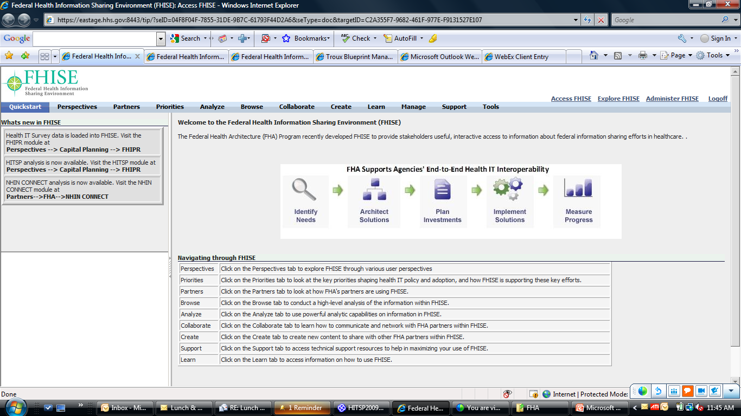
Initial navigation and user interface in FHISE Release 0.1

Slide 23
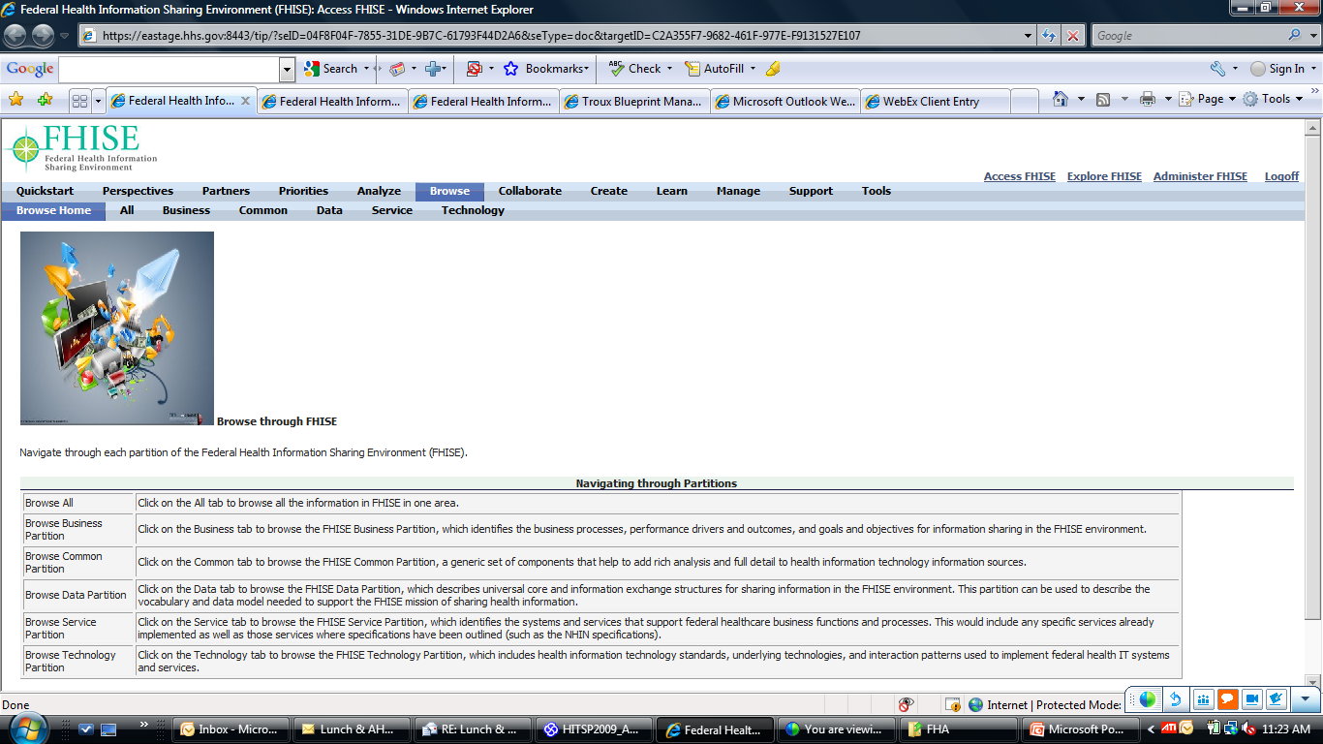
Full browsing capability for FHISE data in FHISE Release 0.1

Slide 24
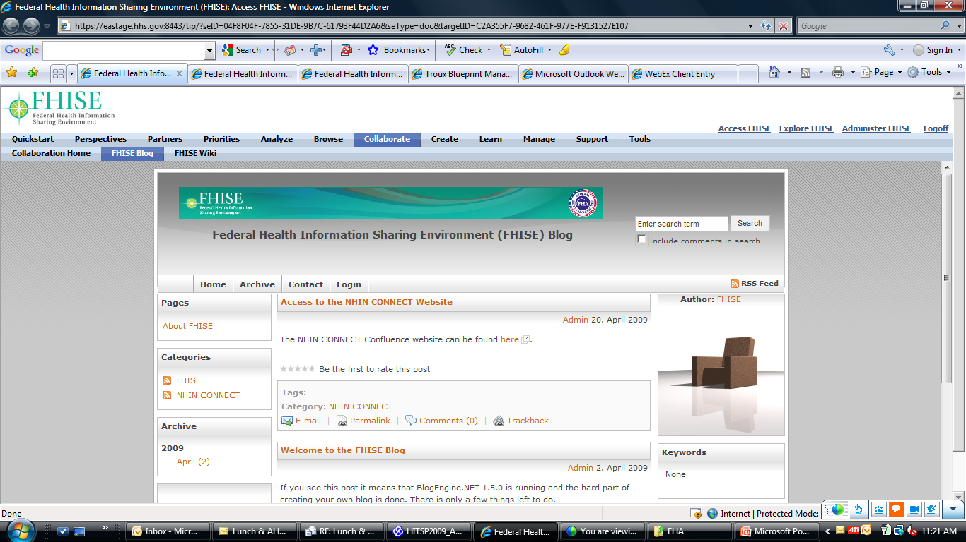
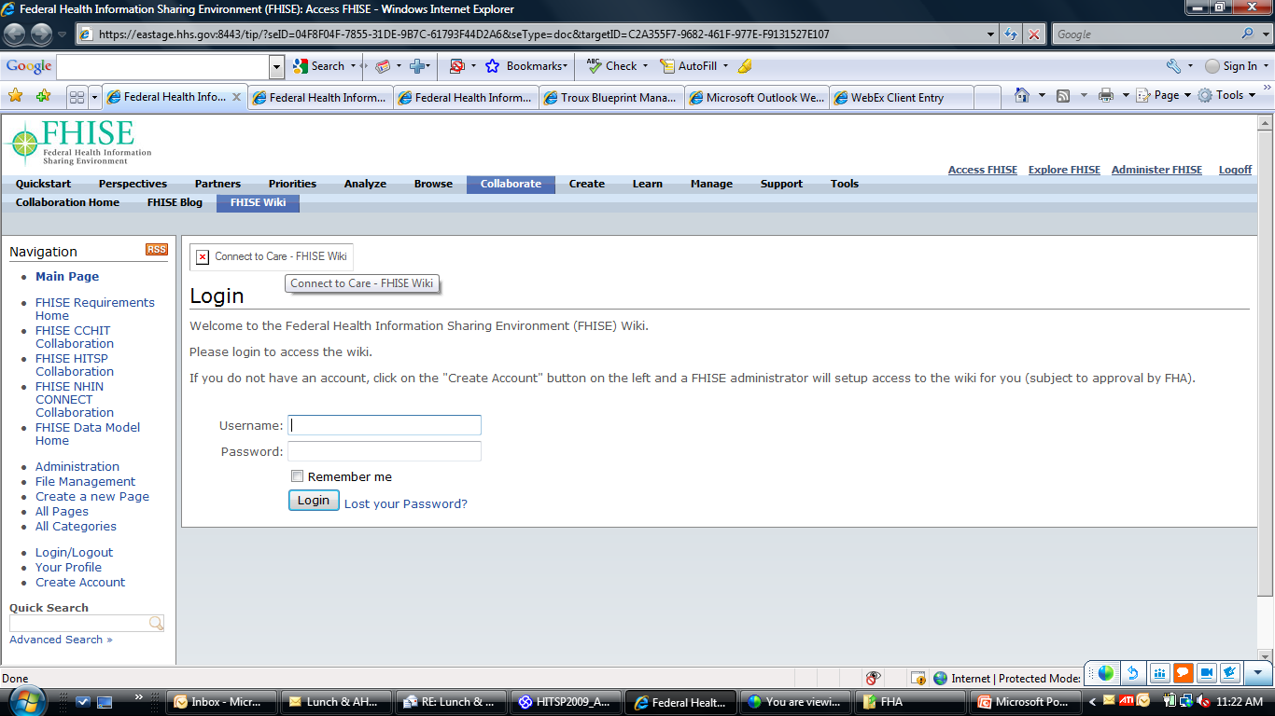
Full blog and wiki built into FHISE Release 0.1

Slide 25
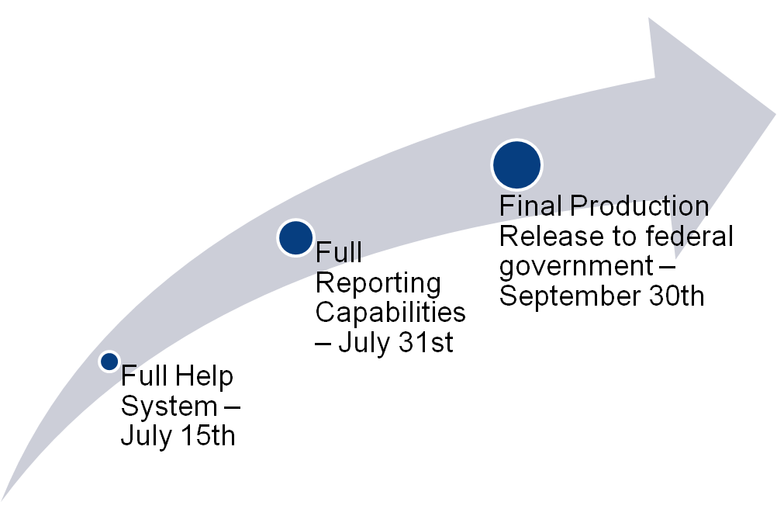
Where we go from here

Slide 26
Comment Period now open
Comments can currently be entered into an attached Excel spreadsheet which will be distributed for all FHA partners
Additionally, comment tracking will be setup on the FHISE Wiki site.
Comment entry will also be added directly into FHISE (to support email)

Slide 27
OMB’s IT Dashboard
Phil Beenhouwer
FHIPR Lead
202.260.2041

Slide 28
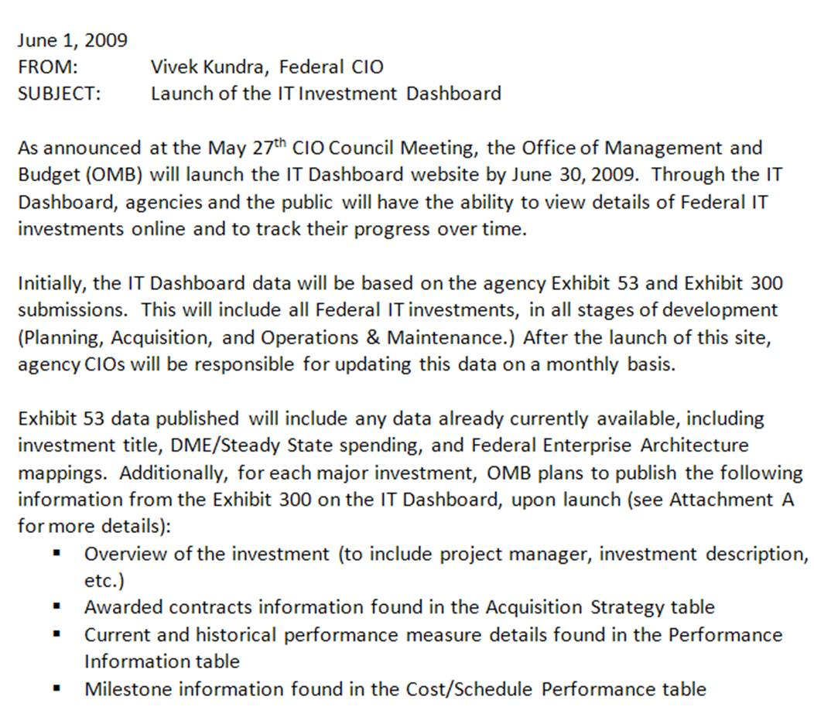
OMB’s IT Dashboard
IT Dashboard website launch:
June 30, 2009
June 1, 2009 Memo
From Vivek Kundra,
Federal CIO
To provide greater insight and transparency into the performance of Federal IT investments
Based on agency Exhibit 53 / 300 submissions
Will include all Federal IT investments, in all stages of development (Planning, Acquisition, and Operations & Maintenance)
Agency CIOs will be responsible for updating this data on a monthly basis
Agencies and the public will have access to his information
Source: www.cio.gov

Slide 29

OMB’s IT Dashboard
Investment
information
Qualitative
Benefits
Initial data fields…
Awarded
Contracts
Summary of
Spending
Performance
Information
Cost/Schedule
Performance data

Slide 30
Discussion

Slide 31

Federal Health Architecture
Contact info: fha@hhs.gov or 202-205-8614

